Slide 1
Notes on Developing a New
Reporting System
Making Post School Outcome Data
Understandable, Useful and Accessible

Slide 2
System Needed to Change
Microsoft ending support for Report Builder
Slow to load, clumsy to navigate
Imperfect at making data understandable and actionable

Slide 3
Our Goals
Report what needs to be reported
  Indicator 14
Help stakeholders take action
  Education and Employment Outcomes

Slide 4
Allow me to Confuse You
Targets: 14A = 19.1%; 14B = 55.4%; 14C = 68.4%
State Rate: Higher Ed.= 18.3%; Comp. Emp= 41.4%
Hypothetical District Data:
  14A= 30%
  14B= 50%
Let’s make an Action Plan!

Slide 5
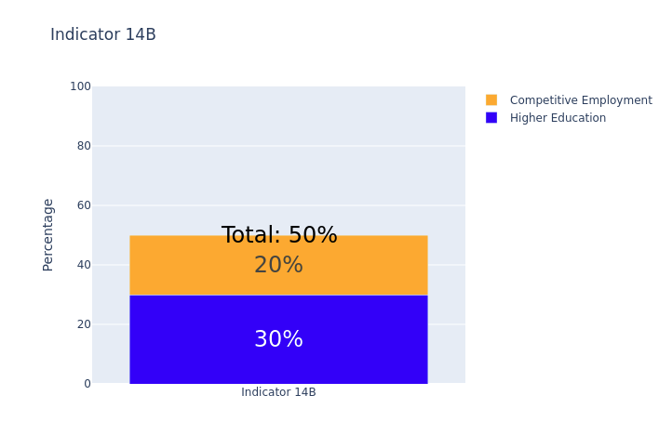
This Should Help

Slide 6
Key Takeaway Points
In terms of higher education, your district has great outcomes
In terms of competitive employment, there is no way to tell how your district is doing

Slide 7
How We Report
The State, SERTACs and Districts will get Indicator 14 Data
  More clearly, in multiple formats, in multiple places
Each will also get a crosstab table showing education and employment outcomes AND how they overlap
Each table can be disaggregated
Each outcome has more detailed reports as well

Slide 8
Let’s Take a Look
(drumroll)

Slide 9
Changing a YOYO Item

Slide 10
Current Item
11. Do (or did) you receive any of the following supports/accommodations at this job?
(Check All That Apply)
  Job coach/employment specialist (someone who offers advice to improve performance)
  Personal aide or assistant (for personal care needs, not specifically work-related)
  Special equipment like computer, braille, furniture, etc.

Slide 11
Proposed Change
Question: Do you receive any of the following supports or accommodations at your job? (Check all that apply)
  Adjustments to job tasks (for example, removing certain duties or having a flexible schedule)
  Accessible equipment or spaces (for example, adjustable chairs, standing desks, accessible restrooms, large-print materials)
  Help with staying organized or reducing stress (for example, job coach, quiet spaces, break areas, checklists, clear instructions, color-coded systems)
  Transportation assistance (for example, help with getting to and from work)
  Assistive technology (for example, speech to text, screen readers, augmentative communication system)

