Slide 1
Kentucky Supported Higher Education Partnership
KITC Quarterly Meeting
January 23, 2026

Slide 2
Human Development Institute (HDI)
Mission
to advance efforts that build inclusive communities, address disparities, and improve the lives of all people who experience disability across the lifespan. We achieve our mission through leadership and community partnerships across Kentucky and the Nation.
Vision
the full participation and contribution of all people with disabilities in all aspects of society.

Slide 3
Higher Education
Kentucky students with intellectual disability (ID) in higher education
Less than 20% (19.2) of students with disabilities (across disability categories) are enrolled at a college or university.
Less than 10% (9.1) of students with ID are enrolled at a college or university.
Kentucky Post-School Outcomes Center (KYPSO), Youth-One-Year-Out (YOYO), 2024

Slide 4

Kentucky Supported Higher Education Partnership (KSHEP)
The Kentucky Supported Higher Education Partnership (KSHEP) is a network of colleges/ universities committed to increasing higher education options, access, and success for students with intellectual and developmental disabilities across the Commonwealth.
KSHEP envisions a higher education system that is welcoming of students with intellectual and developmental disabilities, increasing opportunities for success in academics, employment, and community engagement.

Slide 5
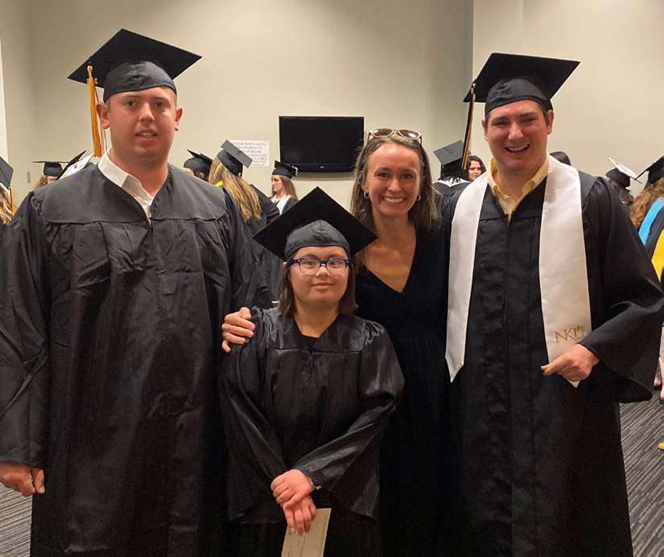
Comprehensive Transition & Postsecondary Programs (CTPs)
Higher education programs for students with ID that have been through an approval process and can offer access to federal financial aid
Created by the Higher Education Opportunity Act (HEOA, 2008)
Support students with ID who want to attend a college or university
Academic and social integration
Individualized person-centered planning
Preparation for success in life and
competitive integrated employment

Slide 6
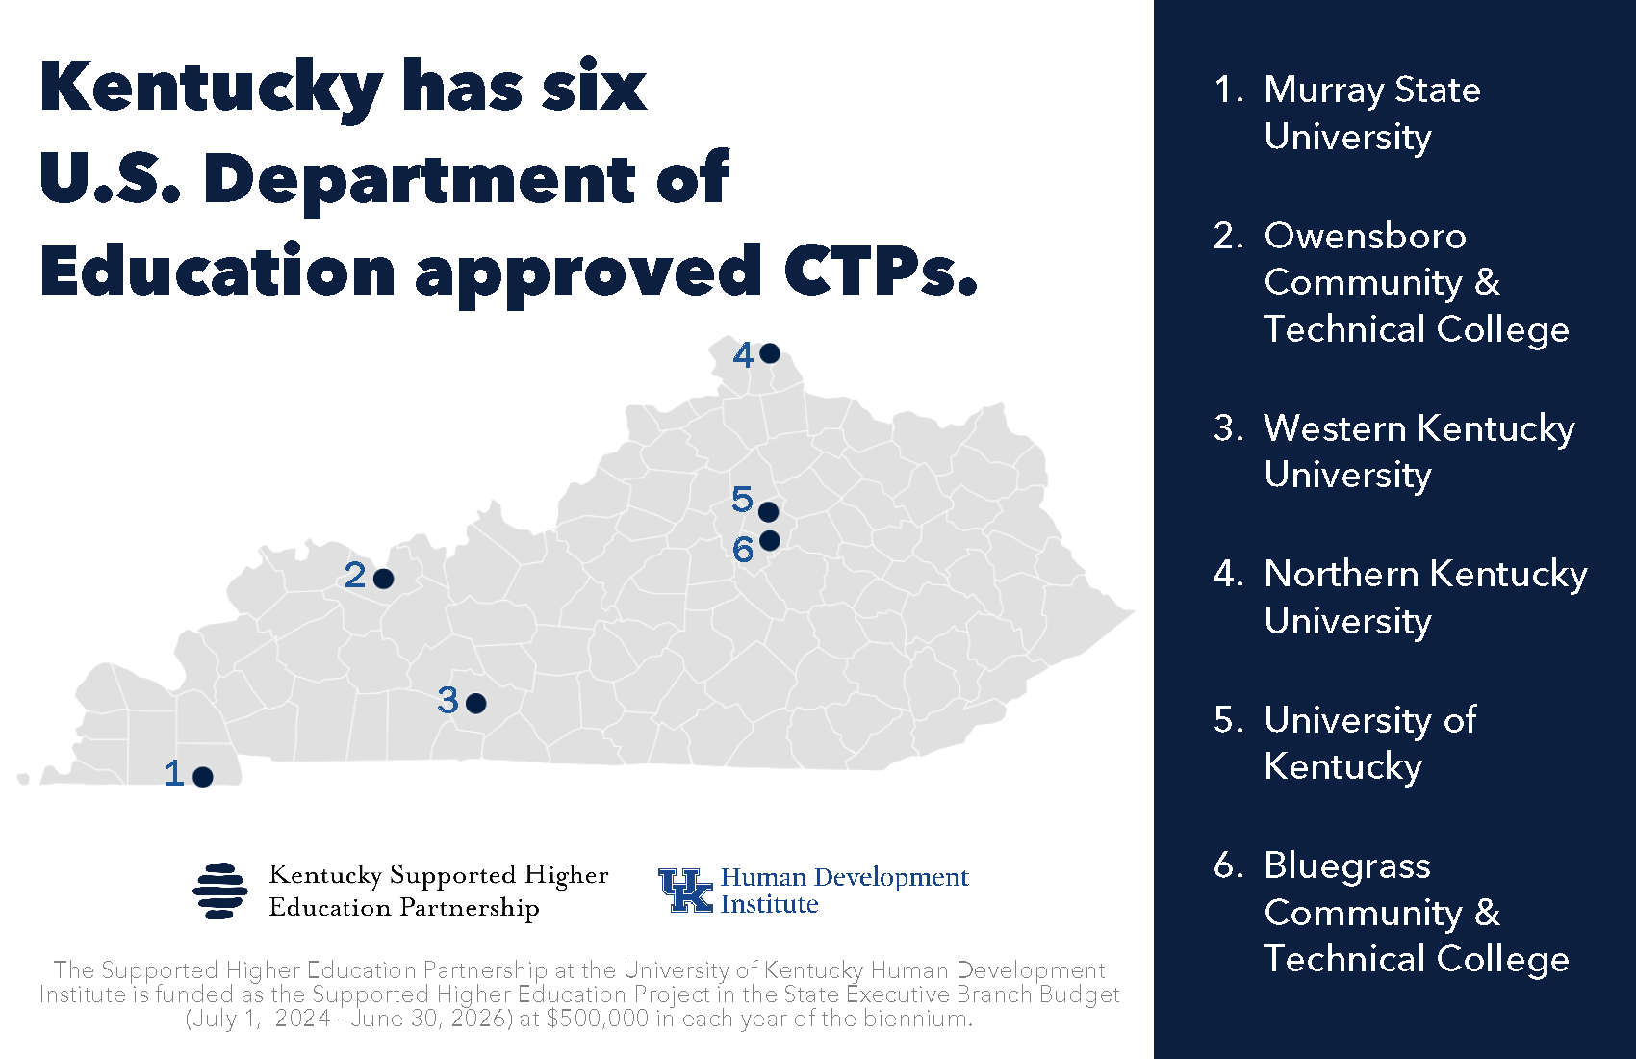

Slide 7
CTPs – Program Eligibility
Students who:
Have a documented ID
Student with an ID means a student –
(A) with a cognitive impairment characterized by significant limitations in:
(i) intellectual and cognitive functioning; and
(ii) adaptive behavior as expressed in conceptual, social, and practical adaptive skills.
(B) who is currently, or was formerly, eligible for a free appropriate public education under the Individuals with Disabilities Education Act.
(HEOA, 2008)

Slide 8
CTPs – Federal & State Financial Assistance
Students with ID enrolled in an approved CTP:
Are eligible for Federal and State financial assistance (even if they do not have a standard high school diploma and are not pursuing a typical degree).
Federal Pell Grant, Work-Study; and
Kentucky Educational Excellence Scholarship (KEES) Program funding.
$500 if enrolled in at least six hours in an academic term.
$250 if enrolled in less than six hours in an academic term.

Slide 9
CTPs & KEES
The ONLY eligibility requirements for students enrolled in an approved CTP to receive KEES are:
Received an alternative high school diploma, or
Attended a Kentucky public HS and is student with ID; and
Enrolled in a Kentucky CTP.
KRS 164.7882
No further application or action is required for the student to receive KEES.

Slide 10

CTPs & Work Ready KY Scholarship Program
Kentucky General Assembly SB 94 (2022 Regular Session)
Amended KRS 164.787 to add eligibility for the WRKS Program to students with intellectual disabilities enrolled in comprehensive transition and postsecondary programs.
“The General Assembly hereby establishes the Work Ready Kentucky Scholarship Program to ensure that all Kentuckians who have not yet earned a postsecondary degree have affordable access to an industry-recognized certificate, diploma, or associate of applied science degree and, for students with intellectual disabilities enrolled in comprehensive transition and postsecondary programs, affordable access to meaningful credentials to prepare for competitive integrated employment.” (KRS 164.787(1))”

Slide 11
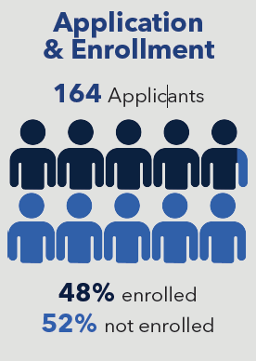


Since 2020. . .

Slide 12


Slide 13

Thank you!
Johnny W. Collett
Johnny.Collett@uky.edu
linkedin.com/in/johnnywcollett/
x.com/johnnywcollett

