Slide 1
Combining Data
YOYO Outcomes with OVR Services
2023-2024

Slide 2
The Big Question
How does a student’s level of interaction with VR impact post-school outcomes?
Does this vary for MSD students

Slide 3
What We Did
Gave SSID numbers of all eligible YOYO Students to KYSTATS
KYSTATS gave us OVR data for each student
Received Pre-ETS
Received Transition Services
This told us
Who got nothing
Who got everything
Merged with YOYO data from 2023 & 2024

Slide 4
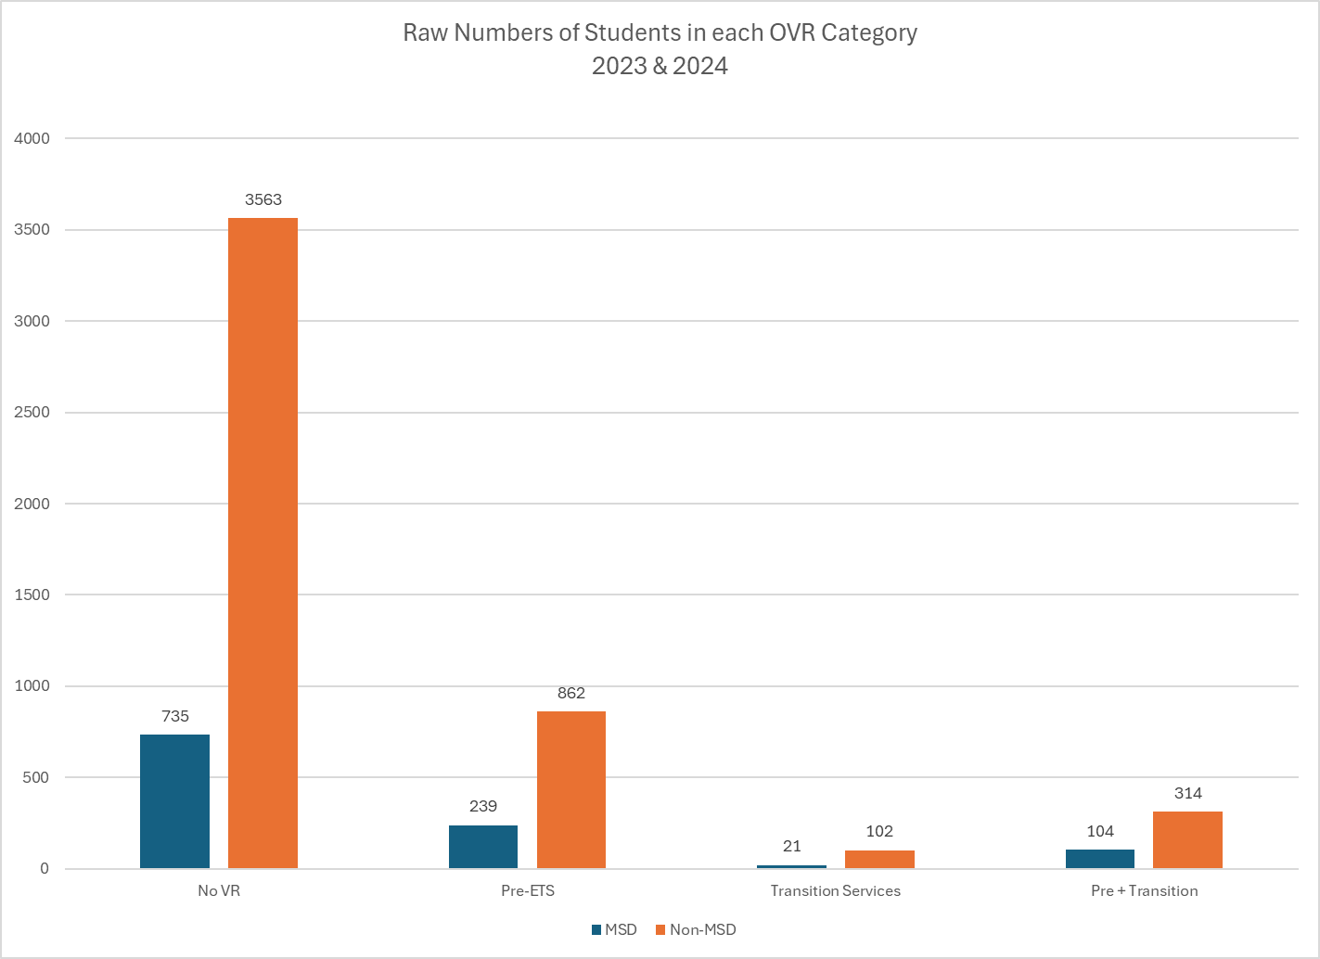
Raw Numbers of Students in Each OVR Category 2023 & 2024

Slide 5
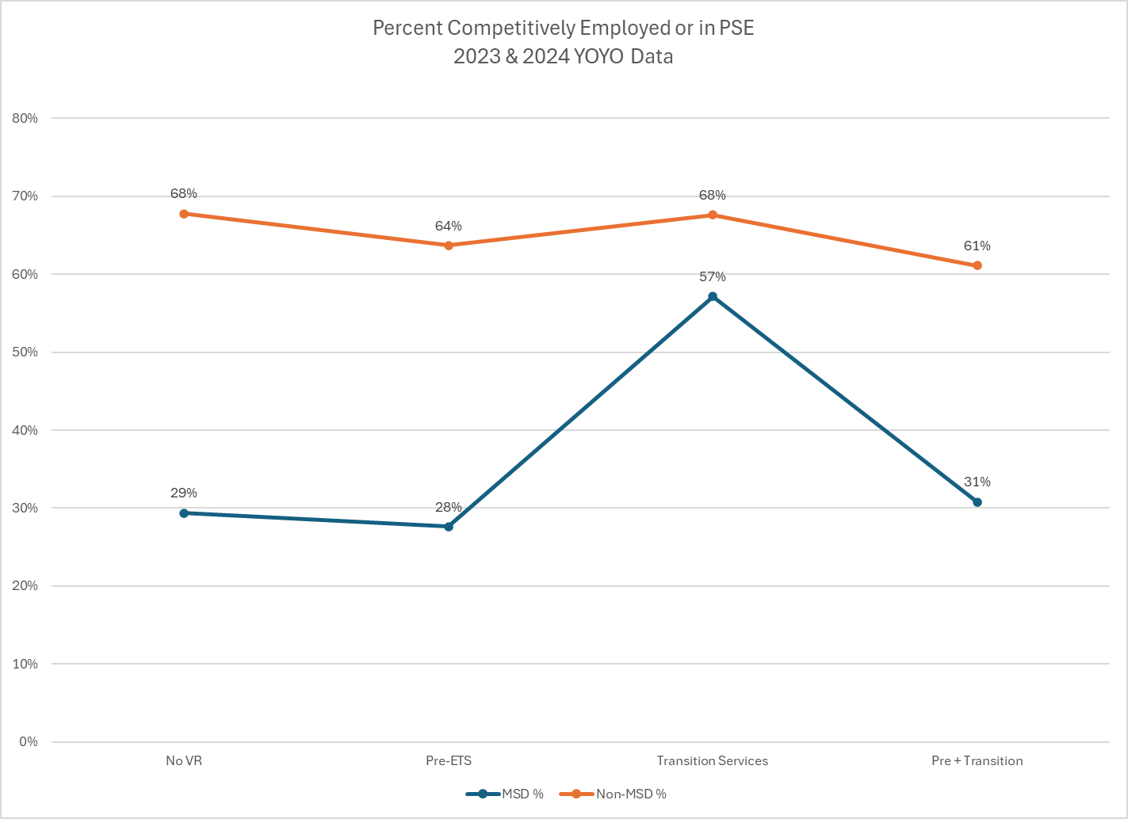
Percent Competitively Employed or in PSE 2023 & 2024 YOYO Data

Slide 6
So now what?
Who are we serving and not serving
What is the value of Pre-ETS alone?
Are there differences for MSD students?
What does the future hold?

Slide 7
I don’t know
That’s why Jonathan is next…

